Slide 1
Manifest Destiny
5.02.1.02- Creates a project that demonstrates an understanding of Manifest Destiny

Slide 2
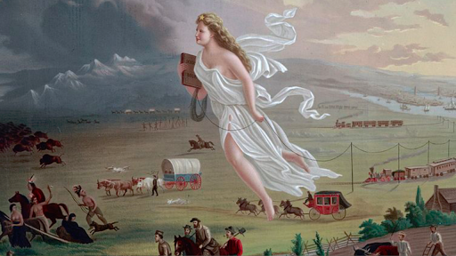
Manifest Destiny:
The belief that it was the destiny of the United States to acquire all land in the western territories

Slide 3
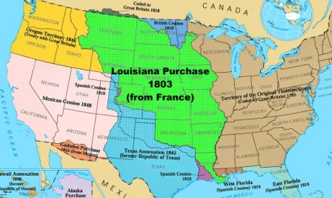
Louisiana Purchase:
President Thomas Jefferson kicked off the country’s westward expansion in 1803 with the Louisiana Purchase, which at some 828,000 square miles nearly doubled the size of the United States and stretched from the Mississippi River to the Rocky Mountains.

Slide 4
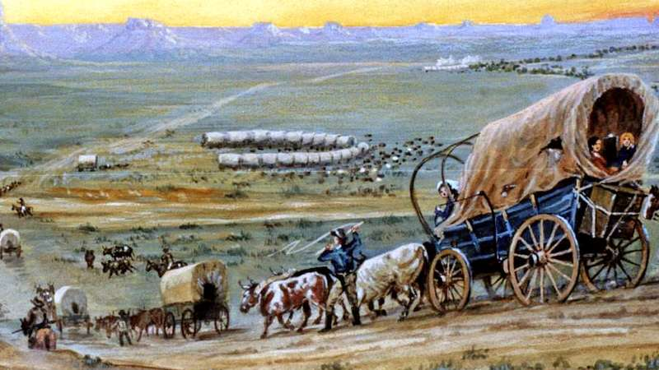
Oregon Trail:
From about 1811-1840 the Oregon Trail was laid down by traders and fur trappers. It could only be traveled by horseback or on foot. By the year 1836, the first of the migrant train of wagons was put together. It started in Independence, Missouri.

Slide 5
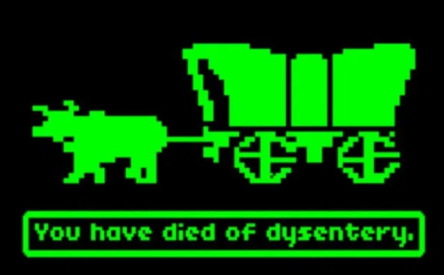
Hardships on Trail:
Travelers were inspired by dreams of gold and rich farmlands, but they were also motivated by difficult economic times in the east and diseases like yellow fever and malaria that were decimating the Midwest around 1837.

